Slide 1


Slide 2

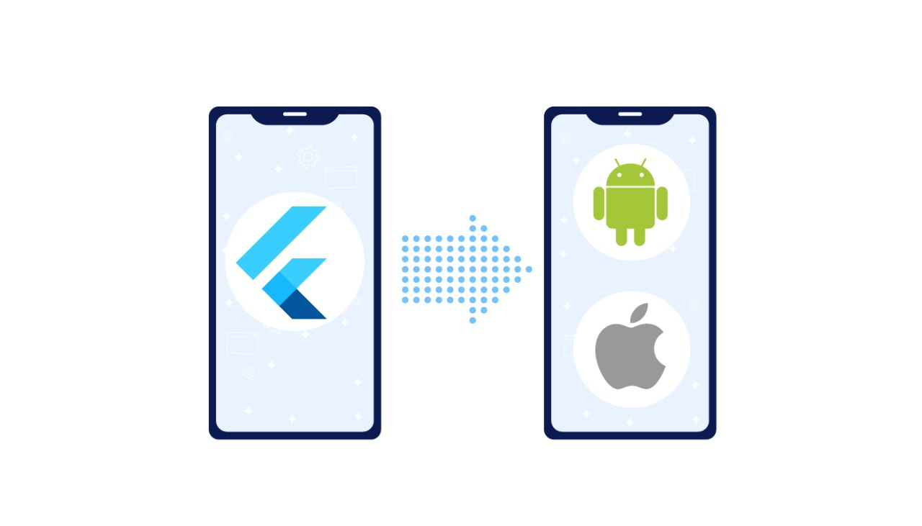
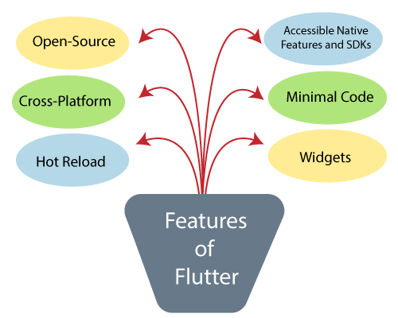
Flutter Features

Slide 3
STEP 01
Learn Dart Programming First
# ফাংশন :Parameters,Returns, Callback, Anonymous functions, Arrow Function, Async/await
......................
# লুপঃ For Loop, For in loop, For Of Loop, Conditional Loop, Nested Loop
......................
# অ্যারেঃ Simple Arrays, Multidimensional Arrays, Array de-structuring, Map, Set.
......................
# জেসনঃ JSON Object, Array,JSON parse
......................
# ওওপিঃ Class, Object, Constructor, Inheritance, Static, final
......................
# এক্সেপশন হ্যান্ডেলিংঃ Try Catch

Slide 4
STEP 02
Flutter Basics
Introduction to the open source SDK by Google
Flutter – Architecture Application
Android Studio Setup for Flutter Development
Getting Started with Cross-Platform Mobile Application using Flutter

Slide 5
STEP 03
Key Widgets
Container class in Flutter
Scaffold class in Flutter with Examples
MaterialApp class in Flutter
Drawer Widget in Flutter
Flutter – AppBar Widget
Flutter – RichText Widget

Slide 6
STEP 04
UI Components
Flutter – Tabs
Flutter – Horizontal List
Flutter – Expansion Tile Card
Icon Class in Flutter
Expanded Class in Flutter
Flutter – Dialogs
Flutter – Circular & Linear Progress Indicators
Flutter – Staggered Grid View

Slide 7
STEP 05
Design & Animations
Customizing Fonts in Flutter
Flutter – Skeleton Text
Flutter – Themes
Flutter – Lazy Loader
Flutter – UI Orientation
Flutter – Animation in Route Transition
Flutter – Physics Simulation in Animation
Flutter – Radial Hero Animation
Flutter – Hinge Animation
Flutter – Lottie Animation

Slide 8
STEP 06
Forms & Gestures
Form Validation in Flutter
Designing a Form Submission Page in Flutter
Flutter – Gestures

Slide 9
STEP 07
Navigation & Routing
Routes and Navigator in Flutter
Flutter – Named Routes
Flutter – Arguments in Named Routes
Multi Page Applications in Flutter
Flutter – Send Data to Screen

Slide 10
STEP 08
Hardware Interaction
Gallery Access in Flutter
Camera Access in Flutter
Background local notifications in Flutter
Restrict Landscape mode in Flutter

Slide 11

STEP 10
State Management

Slide 12
STEP 11
HTTP Request
Get, Post, Delete, Put Request
Request body
Request header
Request Parameter’s , Query strings

Slide 13
STEP 12
Firebase
Push notification
Real-time create, read, update, delete

Slide 14
STEP 13
Simple Practice Project’s
Blog list app
To-do App
Weather App
Expense manager App

Slide 15
STEP 13
Portfolio Project’s
Inventory app
Ecommerce app

